Slide 1
Executive Presence @ Workplace
Can I do It?

Slide 2
Patty?
Was Patty Born with EP?

Slide 3

Executive Presence @ Workplace

Slide 4

What exactly is executive presence?
C
L
A
M

Slide 5

What exactly is executive presence?
Building Confidence in others.
Lifting Others
Being Authentic
Inspiring others to take Meaningful action.

Slide 6
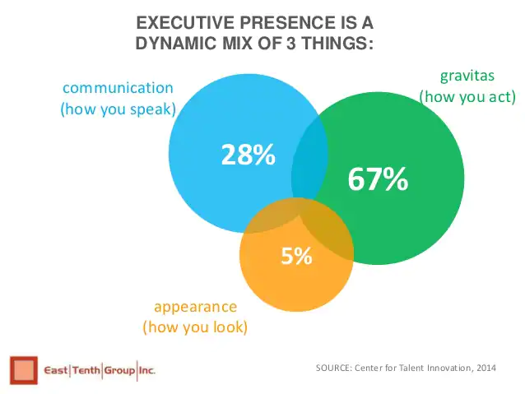

Slide 7
What is Executive Presence Training (And Why it Matters More Than Ever in 2021)
Position Held?
Biggest Challenges?

Slide 8

Journey of Personal transformation ?
Who you are?
The kind of leader you are
and the kind of leader you want to be

Slide 9
Is it a Science?

